Slide 1

Vuclip Prime Product Bible
(Mobile app)

Slide 2
31st December : Code Freeze
1. Sign in: Adding Google Plus, Email as the option and remove SMS (Ignore validation for V1)
2. UI Flow :
a. Main flow
b. Filters
c. My Profile
d. Settings
e. Recommended
f. Resume watching
3. DRM : Player Capability
4. My Videos
a. Storage Management
b. Download Control
5. Notifications
6. Analytics
a. App – App backend
b. App Backend – analytics
7. Billing
a. Carrier
b. Playstore
8. Device Compatibility
9. Brand UI integration

Slide 3
Sign-in page
Sign up : Email
User enters email address and sets the password
Validation email sent to the user on the shared creds
Basic validation check for email address a@x.com
Irrespective of user not validating the email address we let the user enter the app
Sign up : Email
Sign up : Google +
Login
Forgot password
Sign up : Google +
User clicks on sign up with google + Button
Validation performed on the backend for the email address; no email sent here.
User enter the app post successful link
Forgot Password
User clicks on forgot password link
Page/pop-up to ask user to enter the email address registered; if valid send the password reset email to the email address; if not prompt invalid email
Once reset; user can enter the app with the revised password

Slide 4
Sign-in process
User signs up on the app using Google + ; Gmail
Take the user on sign up page to enter email address; password
User enters all the necessary details and hits on register
Post validation take the user directly into the app;

Slide 5
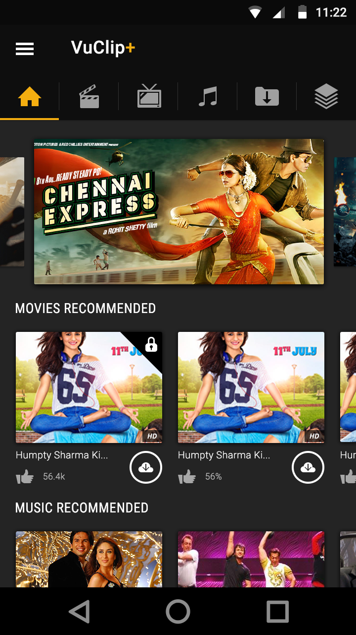




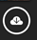
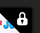
Home Page
Home Page – Leads the user to the home page
Movies– takes the user to the movies section of the app
TV Shows– takes the user to the TV Shows section of the app
Music – takes the user to the music section of the app
My Downloads – takes the user to the “My videos page”
Collections – takes the user to the “packages ” page
Downloads – Download icon; initiate s download when user clicks
Likes – represents # of likes ; from the home page user can’t like content
Paid content – represents paid content ; when user clicks on a paid content; if unsubscribed he will be taken to the payment page
this icon won’t appear if the user has a valid subscription

Slide 6
Home Page
The filters won’t be visible on the homepage and will only show up when the user is in the Movies: TV Shows: Music section
Spotlight section will showcase premium curated content which the content team would showcase. This banner spot could either be a playlist or a single content; the navigation would be a carousal view and the user can navigate either left or right and it would be a cyclic view.
The Spotlight section will be followed by three sections: Recommended Movies; Recommended TV shows and Recommended Music – this section can either be curated by the content team or will be populated by the recommendation API – the sections will only support a left to right navigation

Slide 7
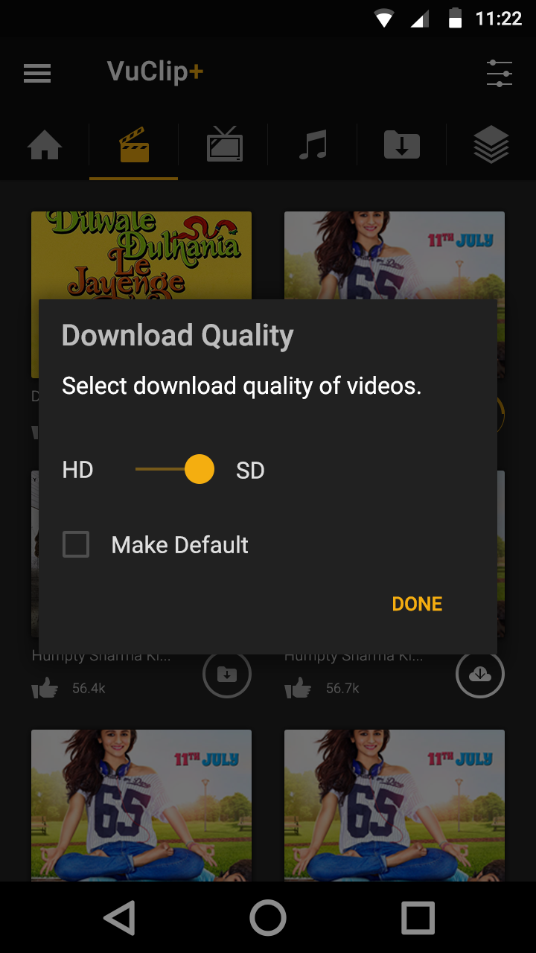



Download
When the user clicks on the download icon; he will see a pop up for selecting the video quality
High (Defined as MENTION PROFILE TYPE)
Low (Defined as MENTION PROFILE TYPE)
Till the time user doesn’t set his default choice of download, he will see this pop up every time we clicks on the download icon and once the default is selected it can be updated from the setting page.
Different states of download Icon
Not downloaded currently
Download in Progress
Already downloaded

Slide 8
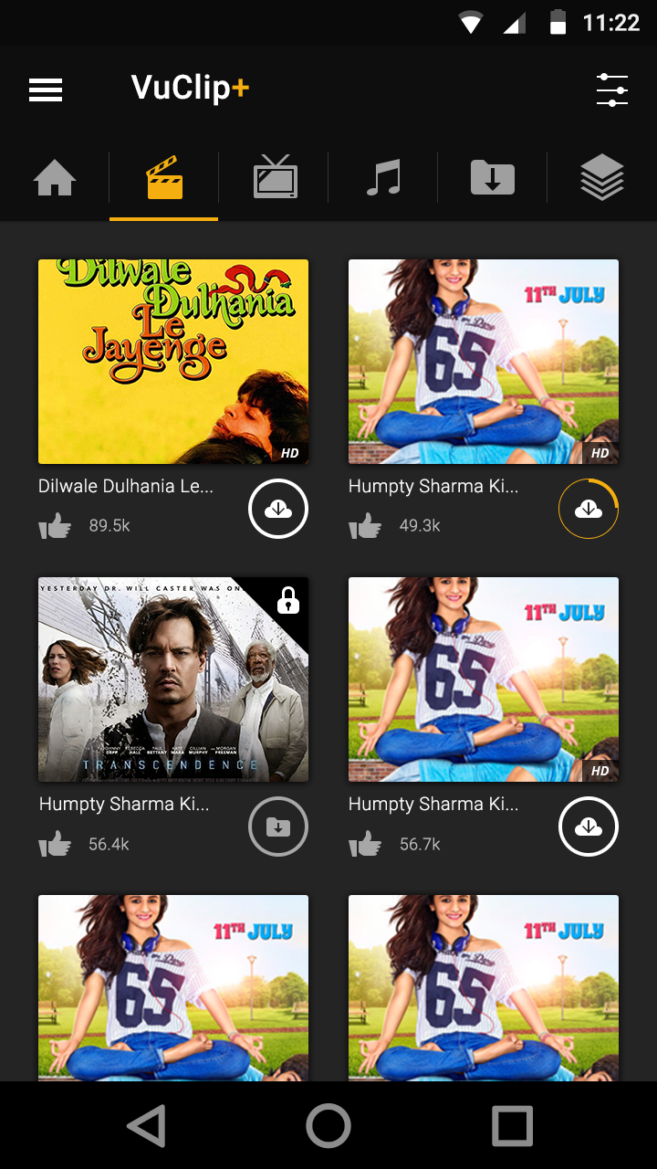
Movies listing Page
The filters will be visible here and the data to be shown here will be in sync with the content tools; when the user clicks on the filter icon he will see a pop-up with the filter values shown as shown in the next slide.
The movie listing page will show the listing of all movie content and will be followed by the movie title; number of likes and the download icon.
This page will follow only vertical navigation.
The definition for likes and download remains the same as explained in the earlier sections. The user can only see the number of likes, there will be no action taken here when the user clicks on the like button.

Slide 9
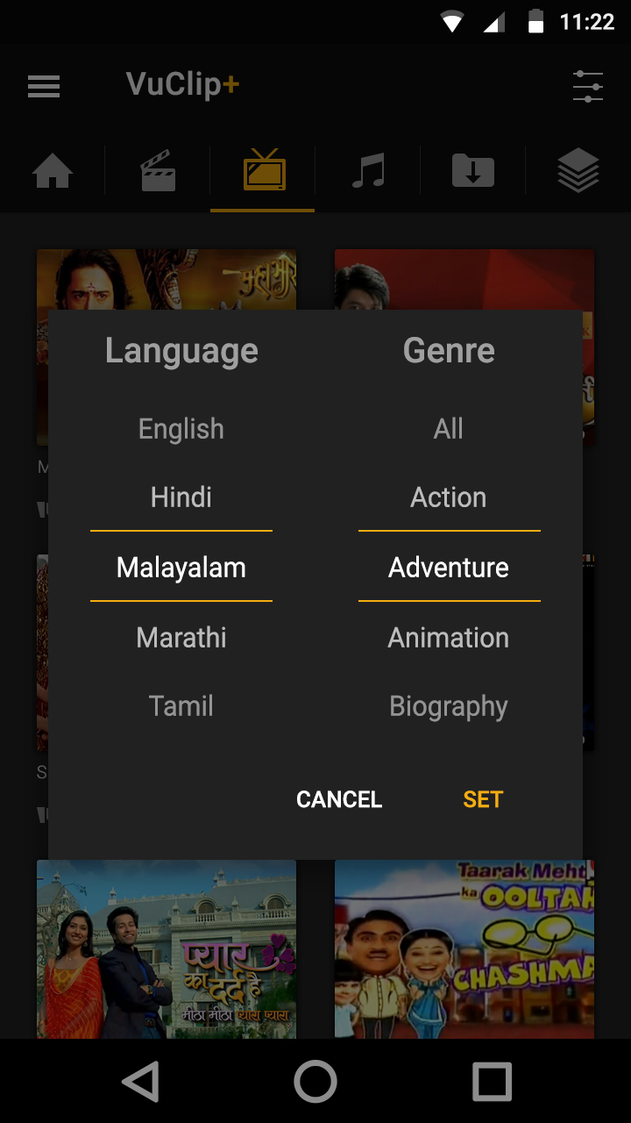
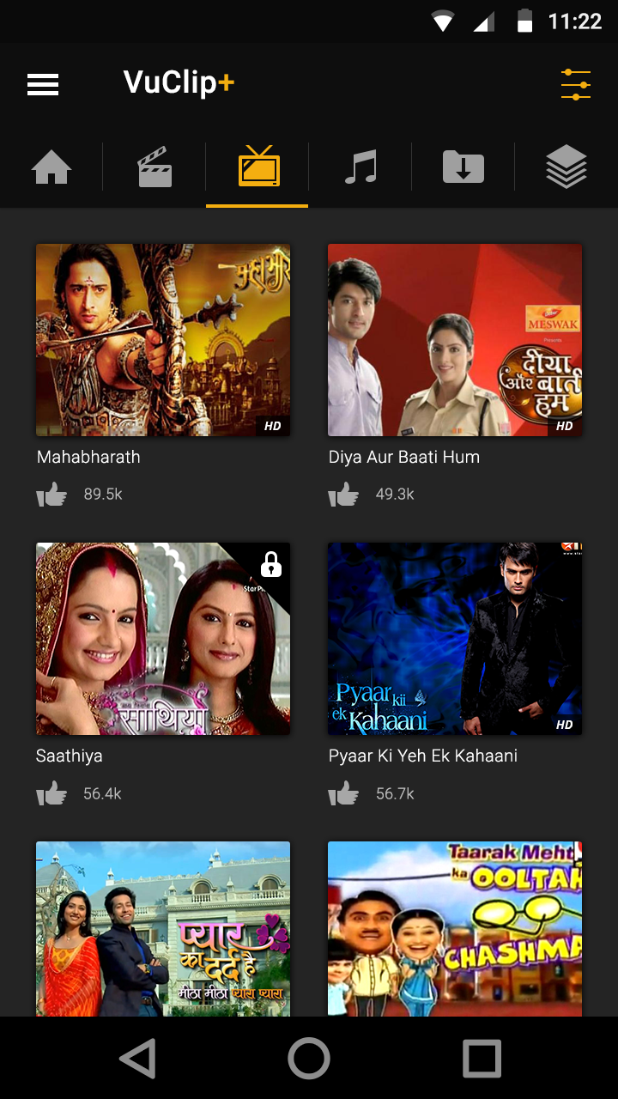
Filters
User can select the filters on whichever page he’s in ; the filters would shown basis the section user is in.
What information to be shown will be picked from the content tools for that section
By default “All” would be selected for both the language and genre selection
Once the user can selected either or both the options on the filters and hit set; the content will be filtered and presented to the user
When he hits on the filter icon again; the previous selected filters will be visible to the user which we can change
Only one language and genre combination can be selected; we won’t allow multiple selection in this version
The filters will be applicable only for the section selected; if the user navigates to another section; the filters would get cleared.
Once the filters are set; the color for the icon changes to yellow as highlighted above

Slide 10
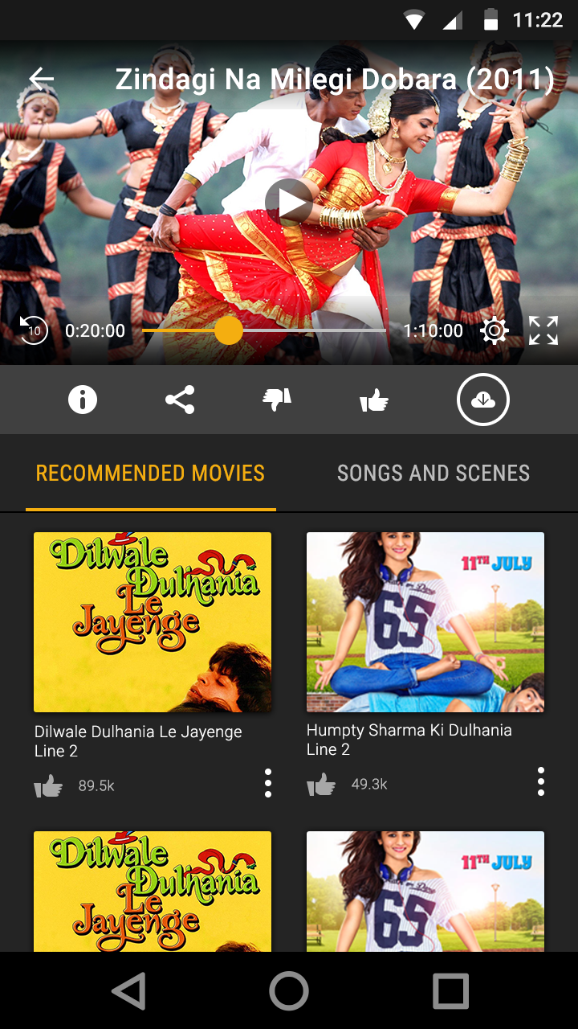


Movies listing Page
Info Icon – clicking on this icon will show a pop-up which displays the content info as passed by the content API
Sharing Icon – clicking on this icon will show a pop-up which displays all the social sharing options
Dislike icon: this icon just shows an action when the user dislikes any video
Like icon: this icon just shows an action when the user likes any video and increments the count of likes
Settings icon: this icon just shows various quality options which the user can select; we can keep the options as Auto; Low; Medium; high
Rewind: this button rewinds the video exactly by 10 secs
Expand : this button will play the content in the landscape mode

Slide 11
Movies listing Page
At the header of the player we will show the video title and when the user tilts the phone; the video will starting playing automatically in the landscape mode.
This is the seekbar; user can seek the video forward or back by pressing on the yellow button
Under the player, the user will see two options.. Recommended Movies : this would be fetched from the recommendation API
Songs and Scenes: this information will be fetched from the content tools if it has been programmed.
Trailers : this also will be fetched from the content tools if it has been programmed.
Songs and Scenes/Trailers will be dynamically fetched; i.e. if the information is available; these sections will be displayed else they won’t be displayed on the app.

Slide 12

TV Shows listing Page
The TV show listing page will contain a list of TV shows; each thumbnail will represent a TV show.
When the user clicks on any thumbnail it will take the user to that particular TV show and will play the latest video in the playlist.
On the bottom on the page; the user will see the list of other episodes from that TV show.

Slide 13
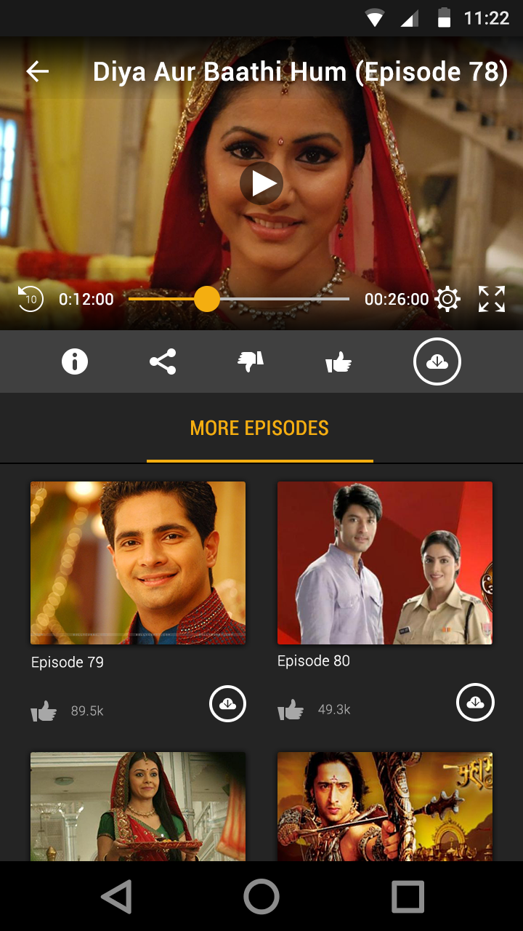
TV Shows Player Page
The difference on the player page for TV shows would be instead of showing recommended TV shows and Songs/Scenes – the user would more episodes from the same TV show.
We’ll only have one section under the player called “More Episodes”

Slide 14
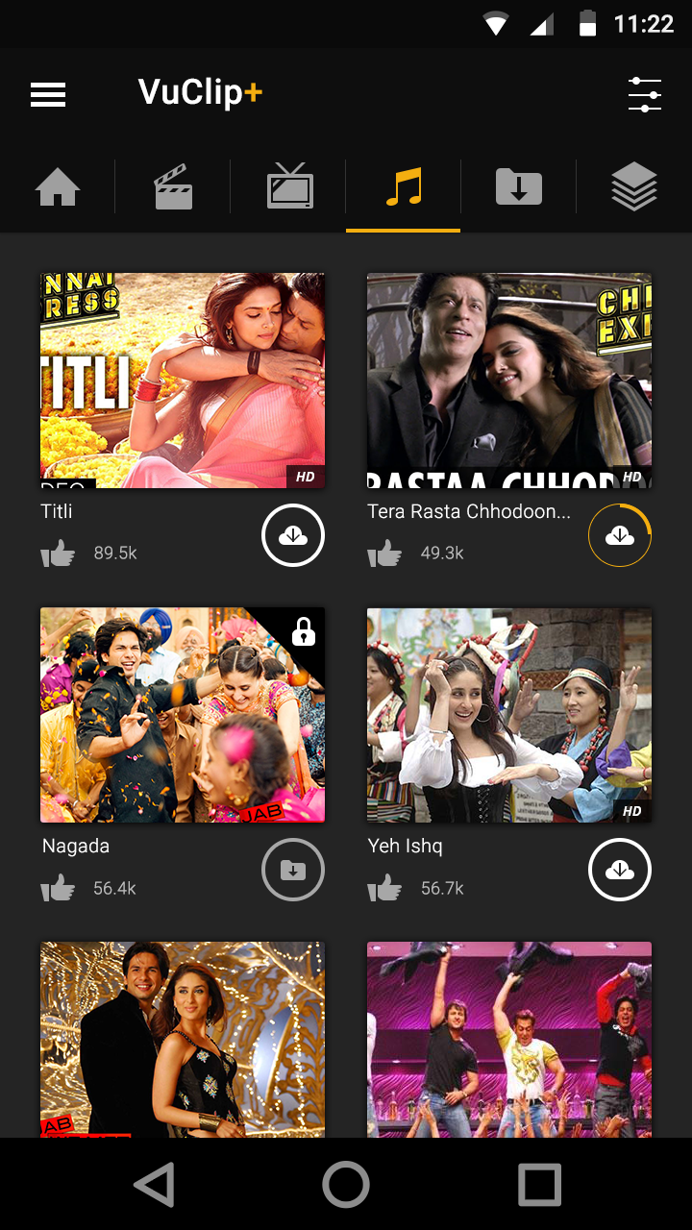
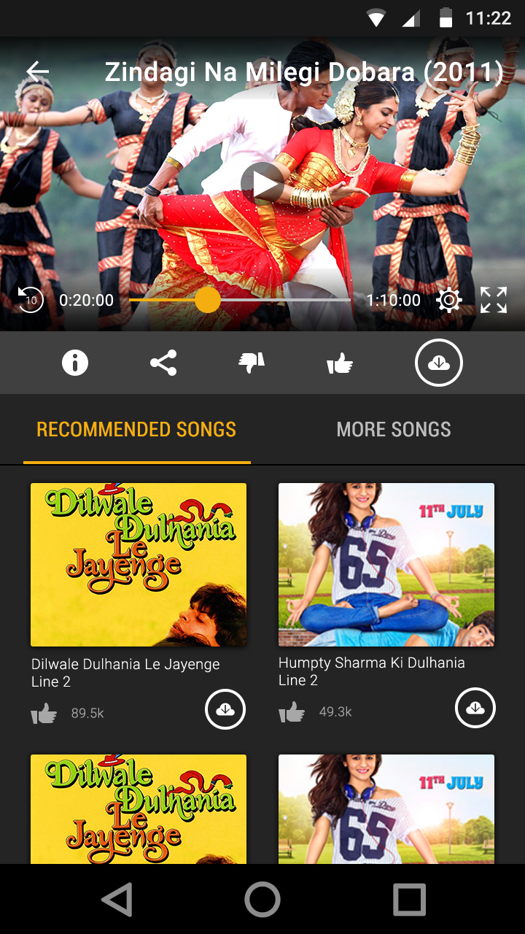
Music Page : Listing and Player Page
The music listing page will be the same as the movies listing page; only change on the sections below the player page

Slide 15
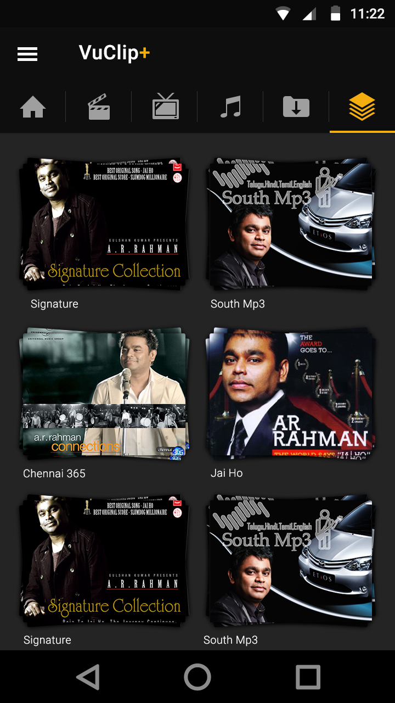
Collections Page – Main Page
The thumbnails for collections is represented differently as compared to regular thumbnails for other content; it’s shown as a stack on thumbnails to represent more content underneath
When the user clicks on the thumbnail for a collection he’ll be taken on a intermediate page where he’ll see all the content under that collection/playlist
This page also will follow only vertical navigation
The music listing page will be the same as the movies listing page

Slide 16
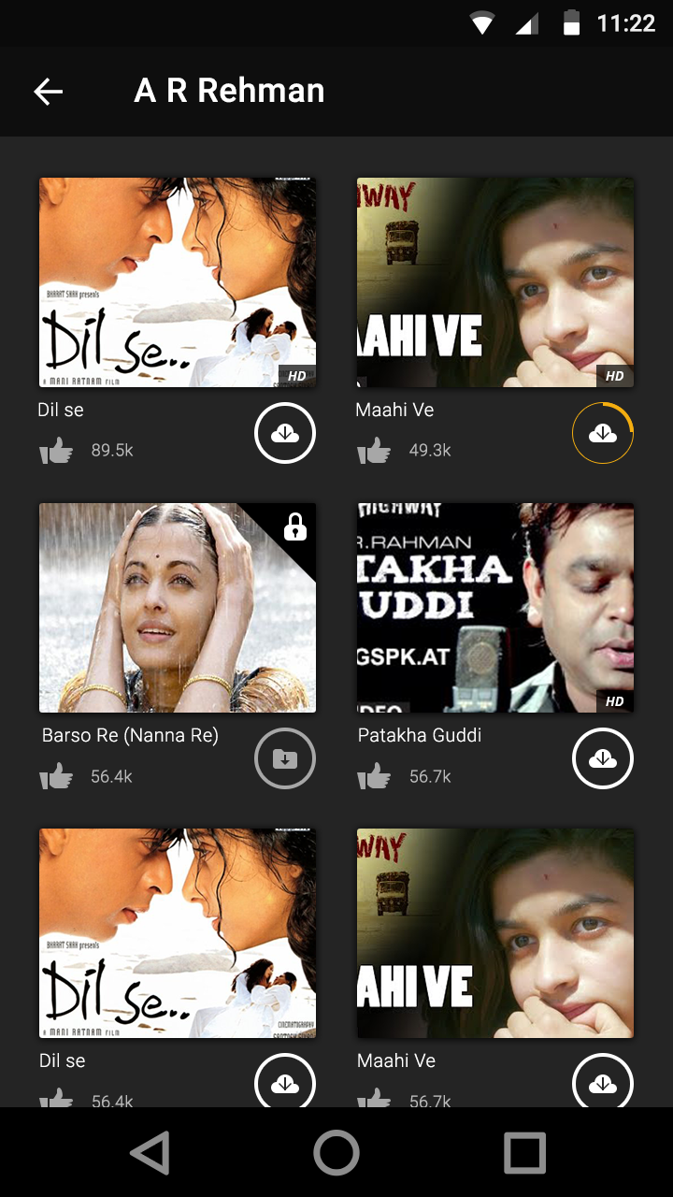
Collections Page – Inside Page
This page would be like a normal listing page as explained during the previous sections of the presentation.

Slide 17
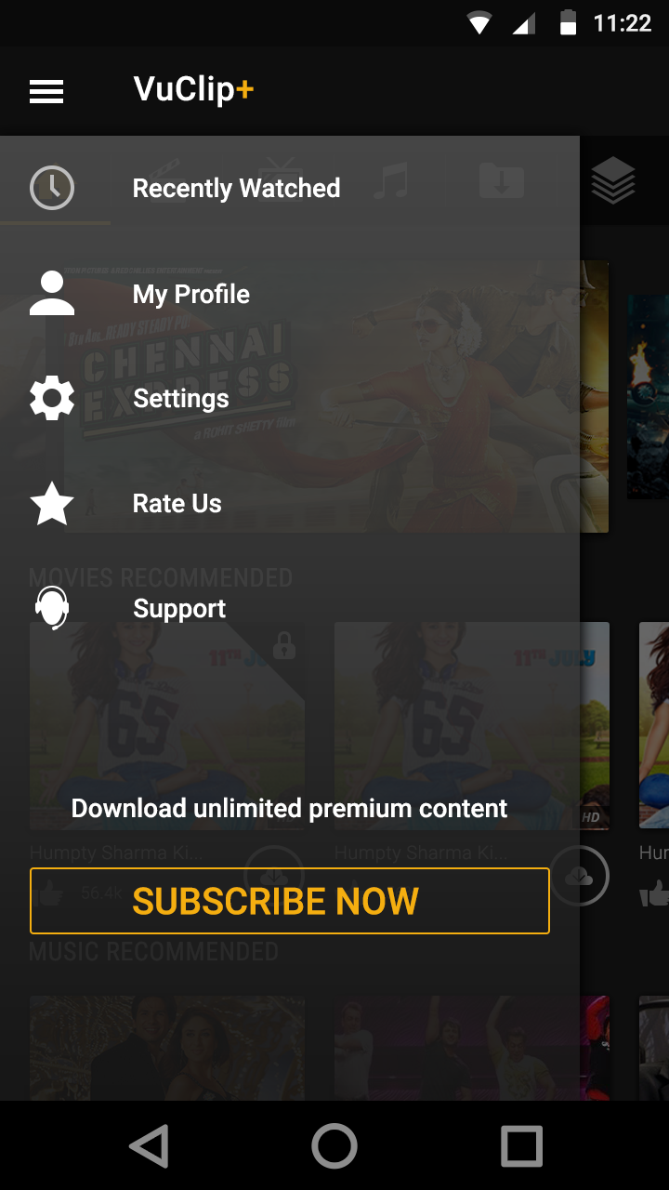
Left Menu Navigation
Recently Watched: All the recently viewed content by the user will be visible here; we’ll show last 100 viewed content for the user in this section.
My Profile: the user can manage his details along with password change and other things on this page
Settings: User can handle history management ; video quality and other details on this page
Rate us : Takes the user to the ratings page of the playstore
Support : Konotor integration for Live chat with the users
Sign-out : user can sign-out of the app using this function

Slide 18
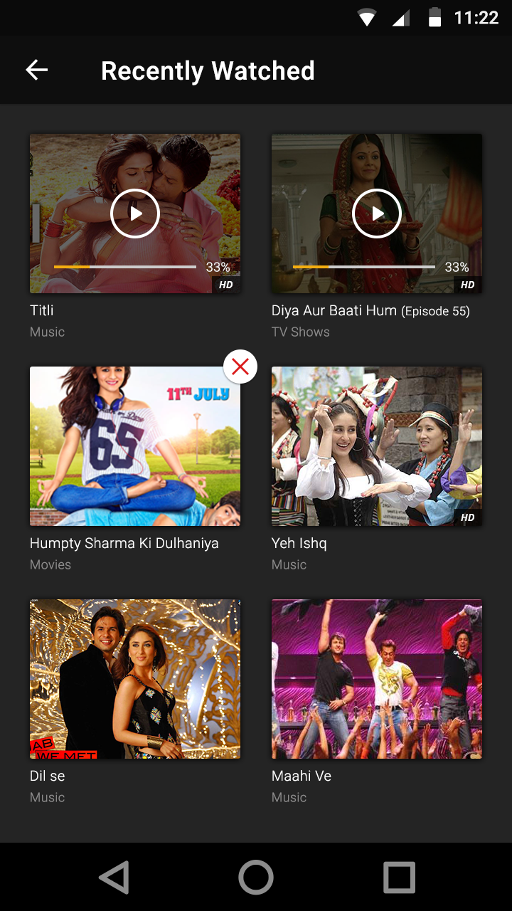
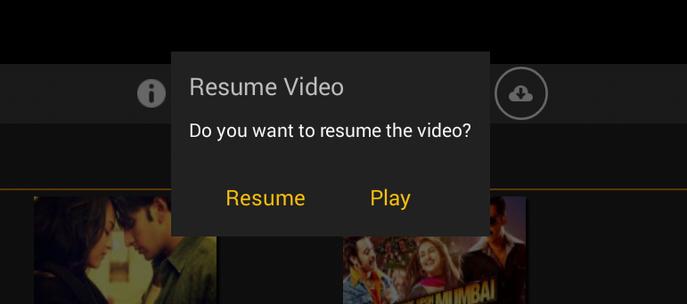
Left Menu : Recently Watched
Recently Watched: All the recently viewed content by the user will be visible here; we’ll show last 100 viewed content for the user in this section.
All the videos which the user didn’t watch completely watch will display the % of the video viewed indicated with the numerical %age and also the same would be represented via the seek bar coloured with till when the content is watched. He’ll also see a play icon on the thumbnail.
When the user clicks on the play icon; he’ll see a pop-up which will prompt him whether to resume the content or stream directly from the start of the video.
With the long press; the user can delete any video he doesn’t want to be shown in the recently viewed history.

Slide 19
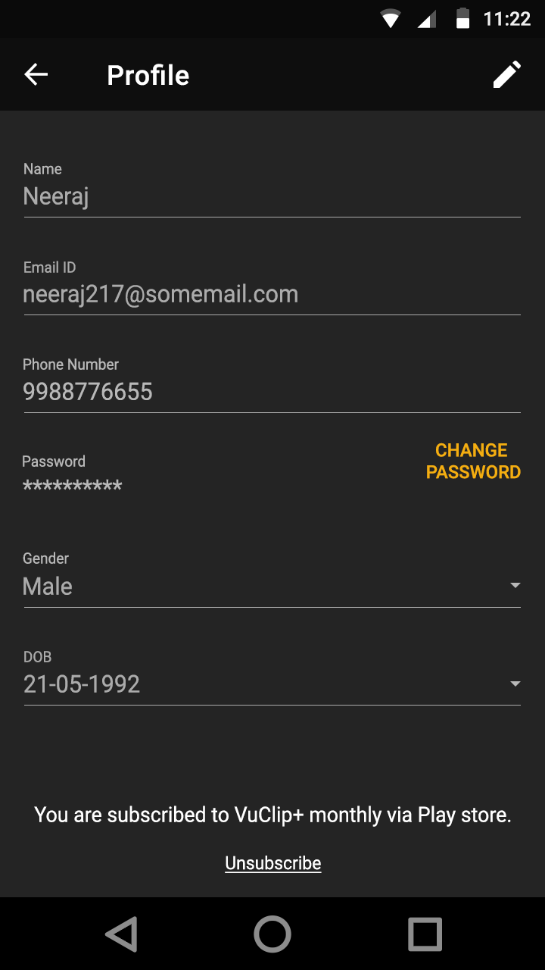
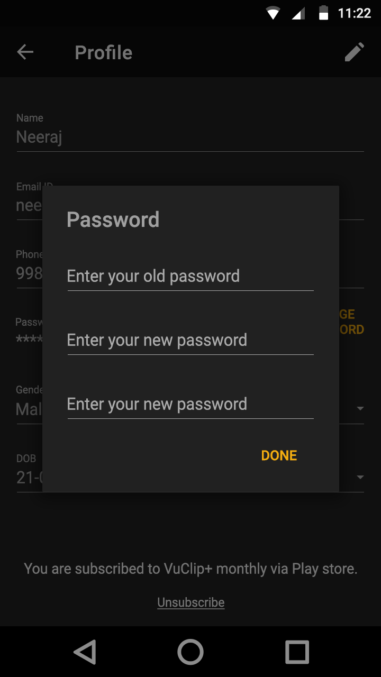
Left Menu : Profile Page

Slide 20
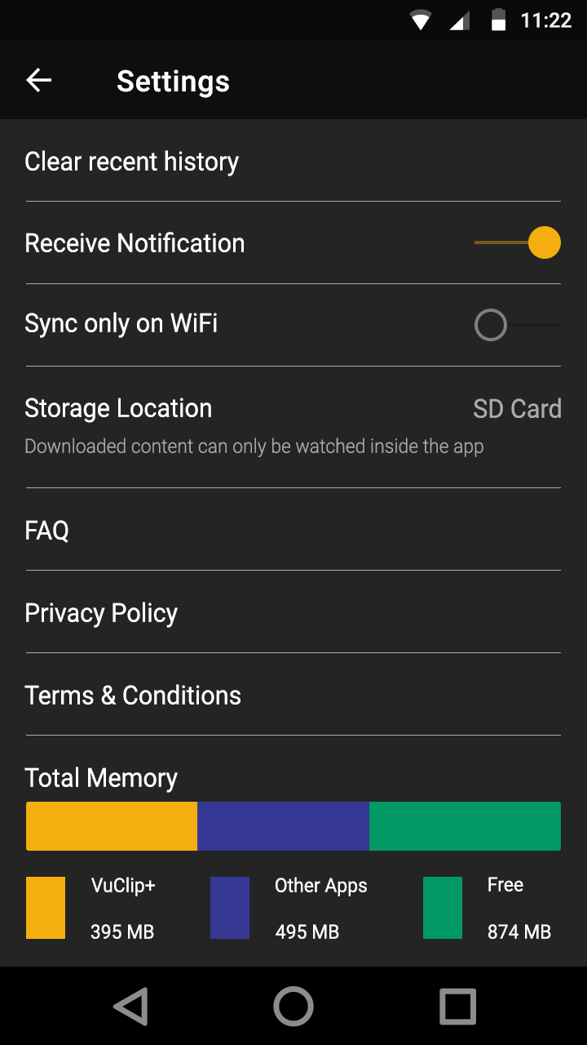
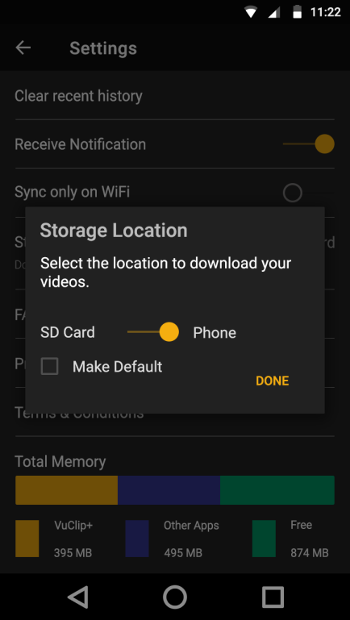
Left Menu : Settings
Clear History : Clears all the history for the recently viewed section; but the user can still be shown the resume option when he clicks on the content he left midway
Receive Notification: The user can opt out of receiving notifications from the app; not to be implemented as a part of V1
Sync only on Wi-fi: if this option is checked ; the queued download will start automatically when the user comes into an active wi-fi zone
Storage Location : the use can selected his storage location from SD Card: Internal memory. This option will change on clicking on the SD card text.
Total Memory : here we will display; what’s the total memory available on the selected memory option , what’s the %age consumed by vuclip; what’s the % of free memory available

Slide 21
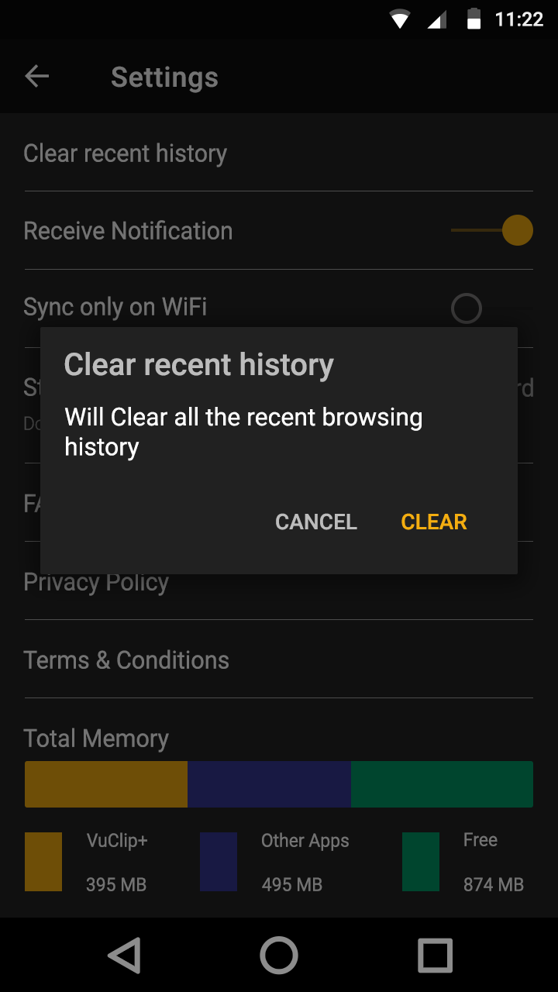

Left Menu : Pop-up messages
Clear history pop-up message
Change Storage location

Slide 22
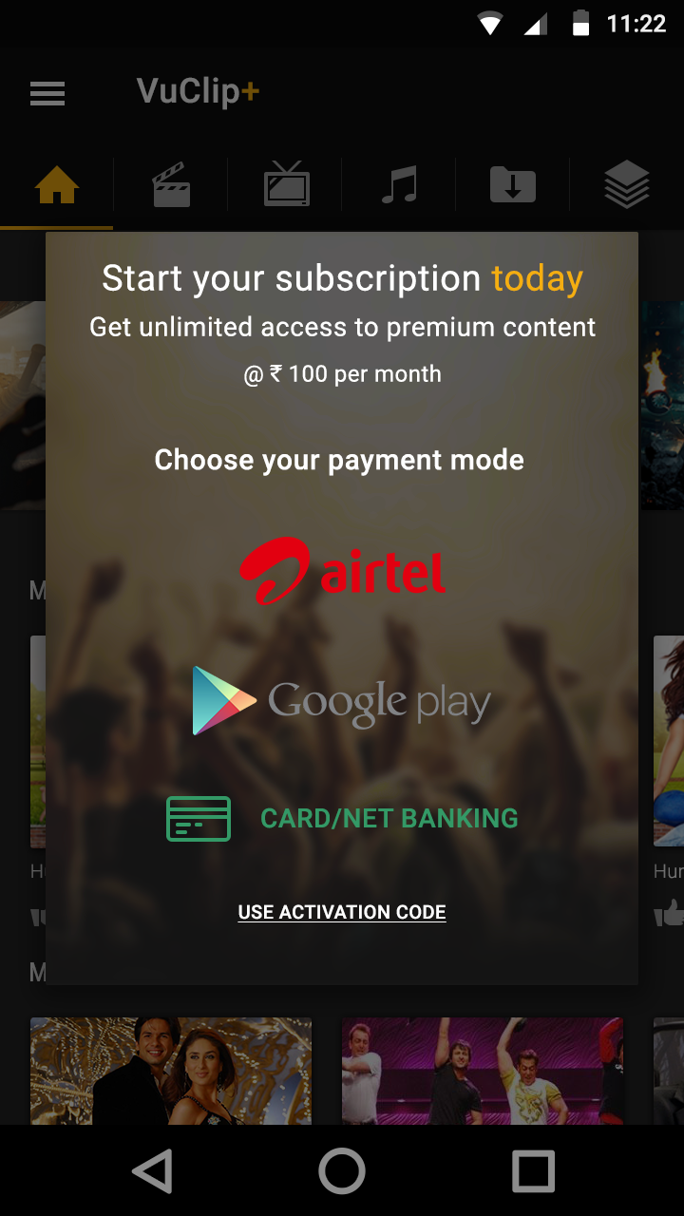
Payment options : Payment Page
When the user clicks on any paid content; he’ll see the subscription option screen.
This screen would showcase the various payment options which the user can use for subscribing to the app;
Carrier Billing : Airtel /Vodafone: DU/Etisalat (V1)
Google Play (v1)
CC/Net Banking/Promo code: V2 of the release
Once subscribed – all lock symbols will be removed from the paid content
This UI will change post the re-branding

Slide 23
Payment options : Carrier Billing
CG page for double confirmation
UI controlled by carrier
Success: Show congrats
Failure: Show sorry

Slide 24
Payment options : Google Play Billing
UI controlled by GP
Success: Show congrats
Failure: Show sorry

Slide 25
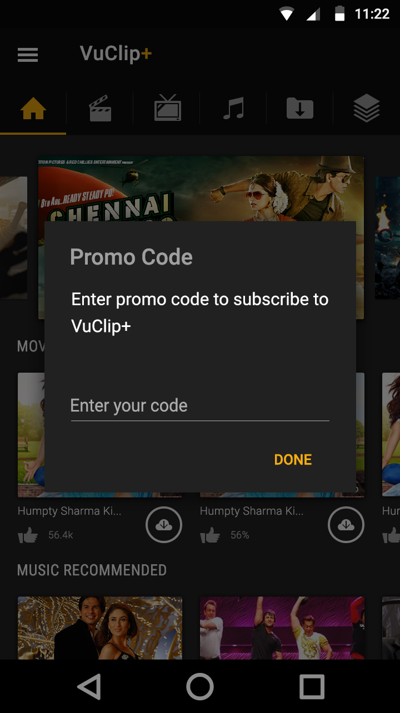
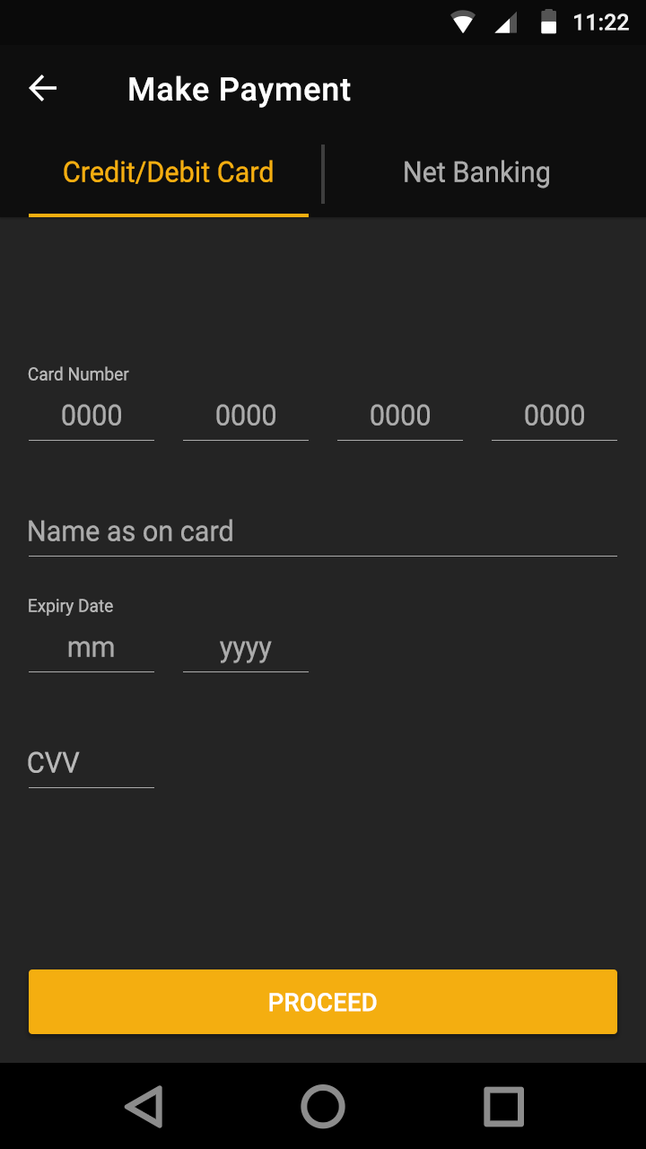
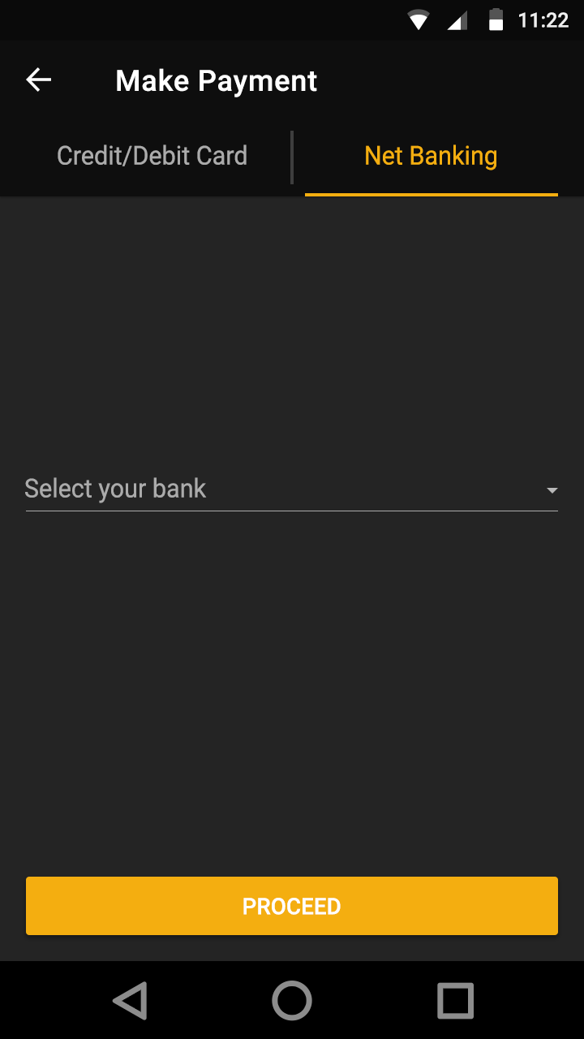
Payment options

Slide 26
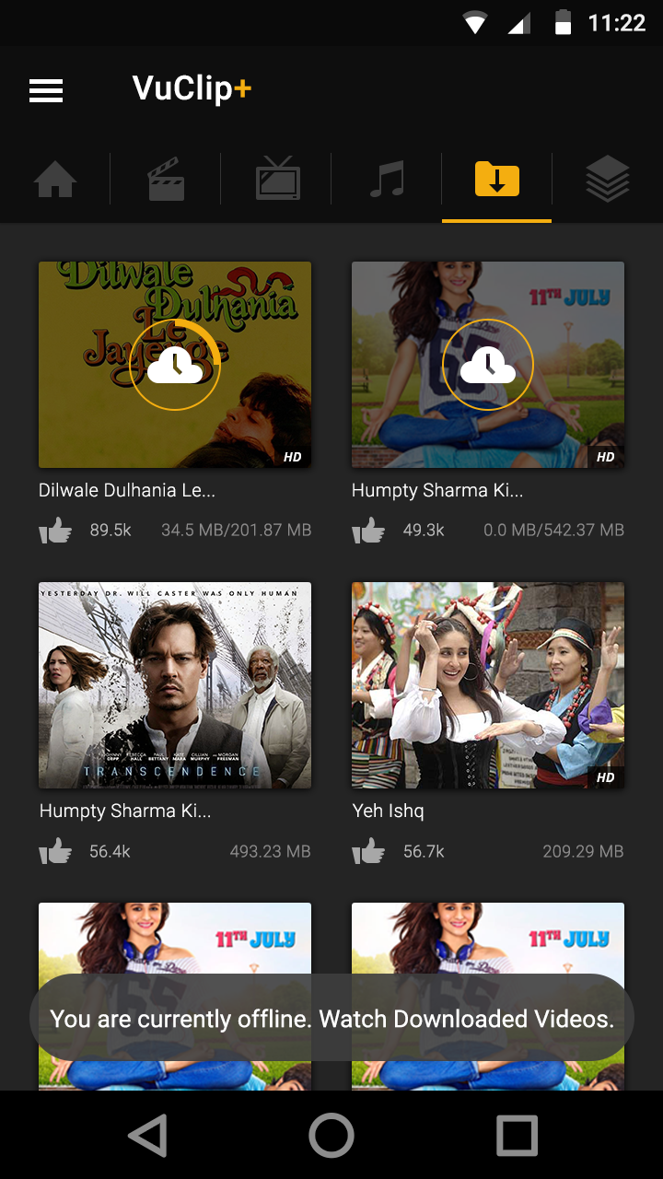
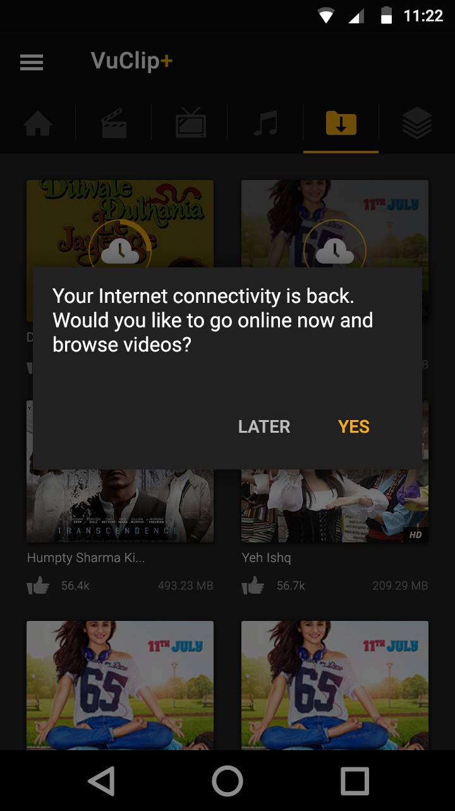
Offline Playback
When the user opens the app in the offline mode; he will only be able to access the download section and only the content which has been downloaded on the app. the rest of the section will be disable d and he won’t be able to click anywhere.
When he clicks on any other screen he’ll see the following toast message as shown in the mock-up)
If the app gets the internet connectivity during the session; we’ll show the user go back online message

Slide 27
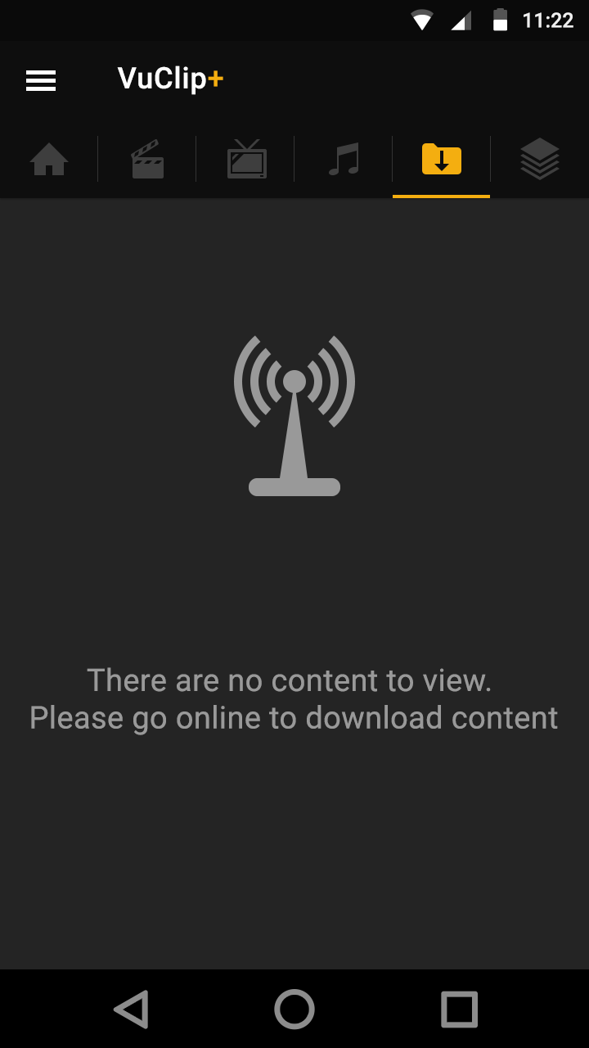
Offline Playback

